Slide 1
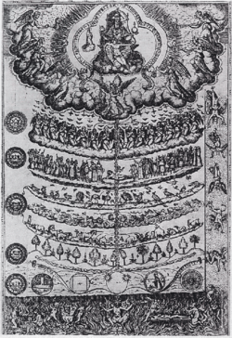
The Elizabethan World View
and Challenges to Traditional Thought
Jennifer A. Bennett
Sanderson High School
Raleigh, North Carolina
Wake County Public School System

Slide 2
Traditionally Accepted Beliefs
Important underlying principles:
The universe has an established order, set in place by God.
Balance is imperative to maintaining that order.
Disturbing that balance can have disastrous results.

Slide 3
The Great Chain of Being
Christian concept (see Psalm 8)
Highly detailed, strict hierarchy (ranking) of all matter and life
Shows the order of everything and its relationship in importance to everything else
Six major divisions (and lots of subdivisions!)
Everything linked together

Slide 4
The Great Chain of Being
Spirit
GOD (Primus Mobile)
Angelic Beings
Mankind
Rational Soul
Animals
Plants
Inanimate Earth
Matter

Slide 5
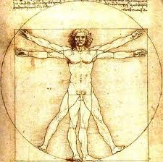
Balance and Order
a delicate balance within these hierarchies
knock something out of order, and the whole system could collapse
chaos ensues—loss of order and control
The Humours
Four fluids in man’s internal system had to have balance
blood
phlegm
yellow bile
black bile
Affected temperament

Slide 6
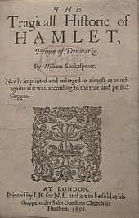
“What a Piece of Work is a Man”
Caught in the middle between the spiritual and the physical
Spiritual/divine soul anchored to a physical body
SO man caught in a continuous struggle
between earthly passions (like animals)
and heavenly aspirations (like angels)
immortal soul housed in a mortal body
What sets man apart from animals?
a rational soul
Hamlet 1.2.129-59, esp. 150-1
Hamlet 2.2.300-6

Slide 7
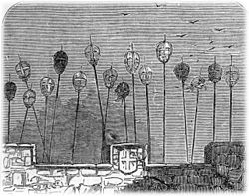
What About Royalty?
Monarchs ruled by divine right
Considered to be God’s viceroy on Earth
Sedition (inciting resistance to or insurrection against lawful authority) or outright rebellion against the king = rebellion against God
Could create great disorder and had dire consequences

