Slide 1
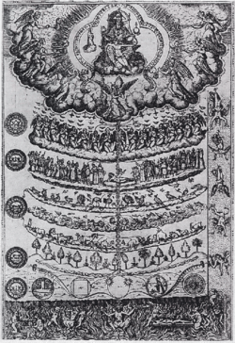
The Elizabethan World View
and Challenges to Traditional Thought
Jennifer A. Bennett
Sanderson High School
Raleigh, North Carolina
Wake County Public School System

Slide 2
Traditionally Accepted Beliefs
Important underlying principles:
The universe has an established order, set in place by God.
Balance is imperative to maintaining that order.
Disturbing that balance can have disastrous results.

Slide 3
The Great Chain of Being
Judeo-Christian concept (Psalm 8)
Highly detailed, strict hierarchy (ranking) of all matter and life
Shows the order of everything and its relationship in importance to everything else
Six major divisions (and lots of subdivisions!)
Everything linked together

Slide 4
The Great Chain of Being
Spirit
GOD (Primus Mobile)
Angelic Beings
Mankind
Rational Soul
Animals
Plants
Inanimate Earth
Matter

Slide 5
The Great Chain of Being
Psalm 8 (King James Version 1611)
O Lord, our Lord, how excellent is thy name in all the earth! who hast set thy glory above the heavens. . . .
³ When I consider thy heavens, the work of thy fingers, the moon and the stars, which thou hast ordained;
⁴ What is man, that thou art mindful of him? . . .
⁵ For thou hast made him a little lower than the angels, and hast crowned him with glory and honour.
⁶ Thou madest him to have dominion over the works of thy hands; thou hast put all things under his feet:
⁷ All sheep and oxen, yea, and the beasts of the field;
⁸ The fowl of the air, and the fish of the sea, and whatsoever passeth through the paths of the seas. . . .
Spirit
GOD (Primus Mobile)
Angelic Beings
Mankind
Rational Soul
Animals
Plants
Inanimate Earth
Matter

Slide 6
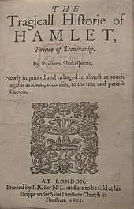
“What a Piece of Work is a Man”
Caught in the middle between the spiritual and the physical
Spiritual/divine soul anchored to a physical body
Humans, therefore, are caught in a continuous struggle
between earthly passions (like animals)
and heavenly aspirations (like angels)
immortal soul housed in a mortal body
What sets man apart from animals?
a rational soul
Hamlet 1.2.129-59, esp. 150-1
Hamlet 2.2.300-6

Slide 7
The Great Chain of Being
Hamlet:
I have of late—but wherefore I know not—lost all my mirth, forgone all custom of exercises; and indeed it goes so heavily with my disposition that this goodly frame, the earth, seems to me a sterile promontory, this most excellent canopy, the air, look you, this brave o'erhanging firmament, this majestical roof fretted with golden fire, why, it appears no other thing to me than a foul and pestilent congregation of vapours. What a piece of work is a man! how noble in reason! how infinite in faculty! in form and moving how express and admirable! in action how like an angel! in apprehension how like a god! the beauty of the world! the paragon of animals! And yet, to me, what is this quintessence of dust? man delights not me: no, nor woman neither, though by your smiling you seem to say so. (2.2.292-305 Pelican ed.)
Spirit
GOD (Primus Mobile)
Angelic Beings
Mankind
Rational Soul
Animals
Plants
Inanimate Earth
Matter

Slide 8
Again from Hamlet
O, that this too too solid flesh would melt Thaw and resolve itself into a dew! Or that the Everlasting had not fix'd His canon 'gainst self-slaughter! O God! God! How weary, stale, flat and unprofitable, Seem to me all the uses of this world! Fie on't! ah fie! 'tis an unweeded garden, That grows to seed; things rank and gross in nature Possess it merely. That it should come to this! But two months dead: nay, not so much, not two: So excellent a king; that was, to this, Hyperion to a satyr; so loving to my mother That he might not beteem the winds of heaven Visit her face too roughly. Heaven and earth! Must I remember? why, she would hang on him, As if increase of appetite had grown By what it fed on: and yet, within a month--
Let me not think on't--Frailty, thy name is woman!-- A little month, or ere those shoes were old With which she follow'd my poor father's body, Like Niobe, all tears:--why she, even she-- O, God! a beast, that wants discourse of reason, Would have mourn'd longer--married with my uncle, My father's brother, but no more like my father Than I to Hercules: within a month: Ere yet the salt of most unrighteous tears Had left the flushing in her galled eyes, She married. O, most wicked speed, to post With such dexterity to incestuous sheets! It is not nor it cannot come to good: But break, my heart; for I must hold my tongue.

Slide 9
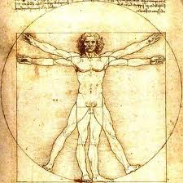
Balance and Order
a delicate balance within these hierarchies
knock something out of order, and the whole system could collapse
chaos ensues—loss of order and control
The Humours
Four fluids in man’s internal system had to have balance
blood
phlegm
yellow bile
black bile
Affected temperament

Slide 10
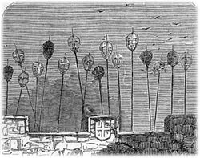
What About Royalty?
Monarchs ruled by divine right
Considered to be God’s viceroy on Earth
Sedition (inciting resistance to or insurrection against lawful authority) or outright rebellion against the king = rebellion against God
Could create great disorder and had dire consequences

Slide 11
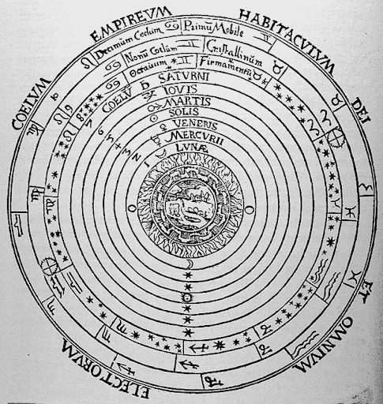
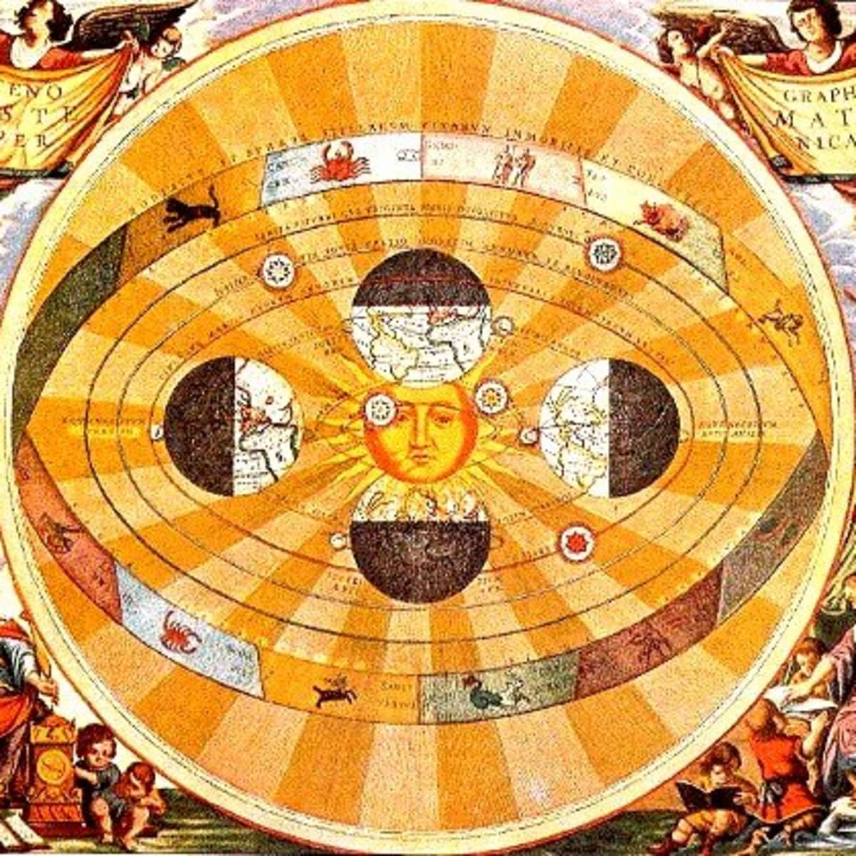
Other Challenges to Traditional Thought
Traditional belief: Ptolemaic model (a geocentric universe)
We are at its center, and everything revolves around us (of course).
New theory: Copernican model (heliocentric universe)
pub. 1543; banned 1616-1835)
Why problematic?
Challenged long-held beliefs and traditional thought about man’s place (importance) in the universe
Notes:
De Revolutionibus was on the Vatican’s Index of Forbidden Works from 1616 until 1835 (https://www.nmspacemuseum.org/inductee/nicolaus-copernicus/)

