Slide 1
The Tudors and Religious Upheaval during the English

Slide 2
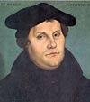
Catholicism
For 12 centuries, England was a Catholic state (catholic = universal)
Protestant Reformation
Began in Europe
Associated most with Martin Luther
1517—Nailed his Ninety-Five Theses to the door of a church in Wittenburg, Germany
Protested the many abuses of the church clerics, including the selling of indulgences
Called out the church on other issues that had no foundation in the Bible:
Pope’s power over purgatory
Merits of the saints, etc.

Slide 3
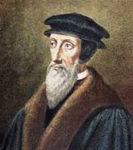
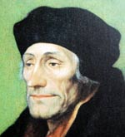
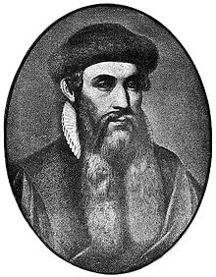
Other Important Figures in the Protestant Reformation
John Calvin
French Protestant
Presbyterian church
Desiderius Erasmus
Catholic priest
Noted Humanist scholar and teacher
William Tyndale
Johannes Gutenberg
http://www.biographyonline.net/people/famous/protestant-reformation.html

Slide 4
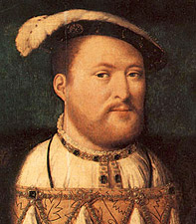
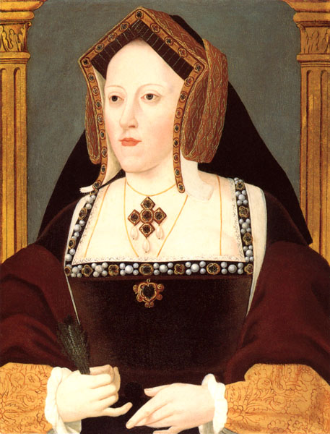
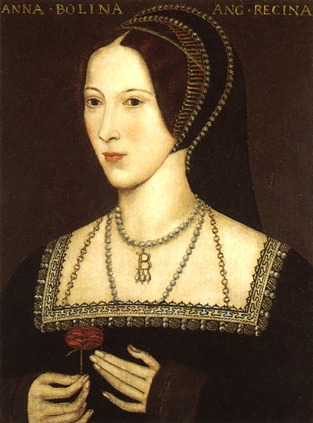
Henry VIII
Pope named Henry “Defender of the Faith”
Wrote Defense of the Seven Sacraments, defending the church practices
Railed against Luther and his movement;
Called them heretics
BUT when he wanted a divorce, and the Pope balked at granting it . . .
He passed the Act of Supremacy

Slide 5
Act of Supremacy
Henry VIII declared himself Head of Church as well as State.
Created the Anglican Church
Church of England
(in America, the Episcopalian Church)
Broke all ties with the Catholic Church and the Pope, including financial ties
Confiscated monasteries
Gave properties as gifts to his supporters

Slide 6
Oath of Supremacy
H. VIII required his nobles to sign
Denounce faith in and allegiance to Catholic Church and Pope
Acknowledge Henry as Head of Anglican Church
Legitimizing divorce from Catherine and marriage to Anne
Affirming that Lady Mary no longer legitimate heir to throne and any children by Anne would have no legal challenges to their succession

Slide 7
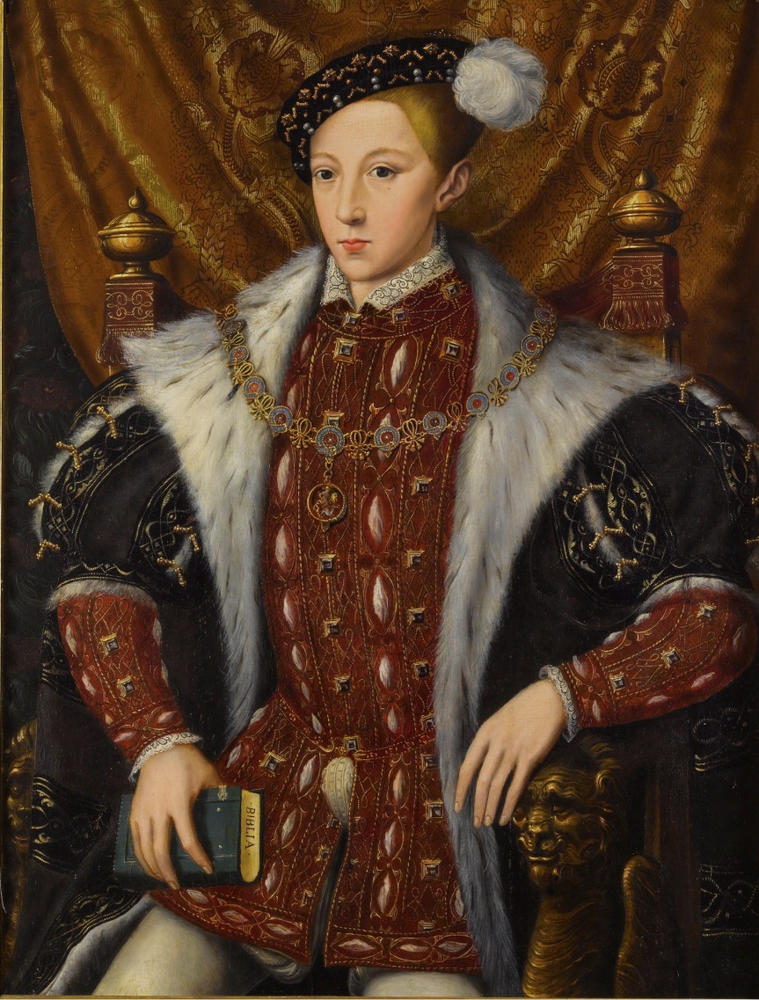
Edward VI
Henry VIII died in 1547
Edward ascended the throne at 9 years old
Uncle Edward Seymour named “Lord Protector”
Other advisors jockeyed for control
Staunch Protestant like his father

Slide 8
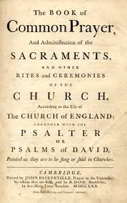
Edward VI: Protestant King
Passed the Act of Uniformity in 1549
Established the Book of Common Prayer as only legal form of worship
Contained the liturgy, all the parts of the structured worship services
Prayers and scriptural readings for each service throughout the year
Full orders for baptism, marriage, funeral, etc. services

Slide 9
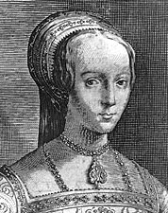
Edward VI: Protestant King
Sickly boy
Died at 15 years old in 1553
Mary I next in line to succeed, according to H8’s will
Edward and Privy Council desperate to maintain Protestant control
Some backed Elizabeth; others backed Mary Tudor’s (H8’s sister) oldest grandchild, Lady Jane Grey

Slide 10
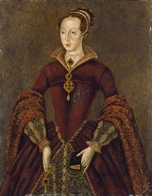
Lady Jane Grey: The Nine Days’ Queen
Committed Protestant and Humanist
Backed by Privy Council
“Reigned” from July 10 - July 19, 1553 (15-16 years old)
Mary I and her troops marched in to London
Privy Council changed mind and proclaimed Mary as Queen on July 19
Convicted of high treason
Executed February 1554

Slide 11
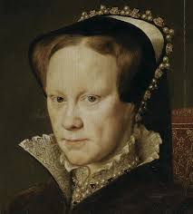
Mary I: The Catholic Queen
Daughter of Catherine of Aragon
Ascended the throne in 1553
Devout Catholic
1st act: to proclaim Catherine’s marriage to Henry valid and legal
2nd act: to undo all the Protestant legislation that Edward had enacted
Married Philip of Spain
Notes:
Philip was son of Holy Roman Emperor, Charles V

Slide 12
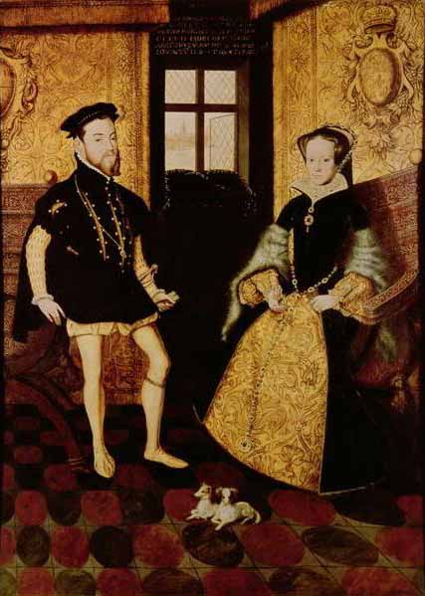
Mary I (aka Bloody Mary)
Desired to return England to the “one true church” and salvation
Forced conversions
Burned over 300 Protestants at the stake who refused to renounce their faith
Reign fraught with conspiracies to overthrow her and place Elizabeth on the throne
Imprisoned Elizabeth but released her
Died childless; in her will named Elizabeth as her successor

Slide 13
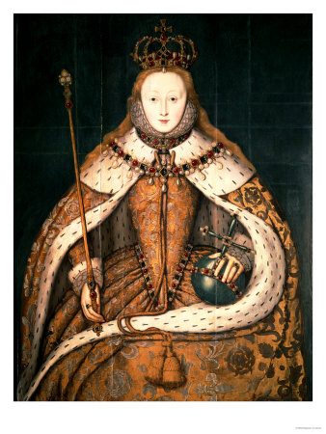
Elizabeth I
Ascended the throne in 1558 (25 years old)
Protestant (like her mother Anne Boleyn and father Henry VIII)
Reinstated the Act of Uniformity and the Book of Common Prayer
Unified religious worship and rituals throughout Anglican church
Unified England under one church and one monarch

Slide 14
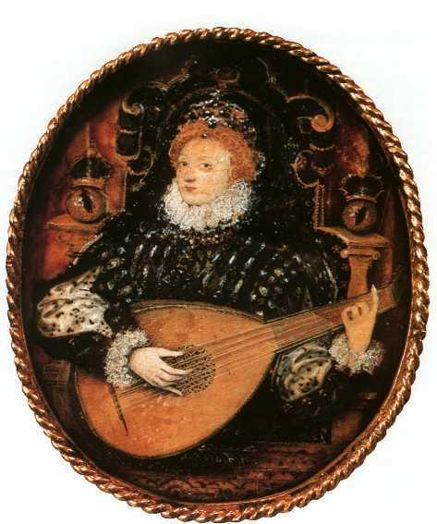
Elizabeth: True Renaissance Woman
Poet/writer
Dancer
Musician
Multilingual (could translate both Greek and Latin) at a young age!
Great political leader

Slide 15
Elizabeth I
Constant threats on her life, monarchy, and country
Many conspiracies and assassination attempts
Catholic church (throughout Europe) and Pope
Catholic nobles (political power)
Mary, Queen of Scots (cousin)
Spain—issues with England:
Catherine of Aragon being kicked to curb and humiliated
Elizabeth refusing to embrace the Catholic Church and maintain Catholic state of England after Mary I
Elizabeth stringing Philip along as suitor, only to reject him in the end

Slide 16
Elizabeth, the Virgin Queen “Better beggar woman and single than Queen and married.”
Remained unmarried, but
Received royal suitors from all over Europe
Played them against each other
Privvy Counsel concerned to marry her quickly after coronation (Elizabeth 32:10) to—
Establish an heir apparent
Secure her reign and
Ensure peaceful succession after her death
Make political alliances that would strengthen England’s position in Europe
While stalling for time, she built England into an independent power.

Slide 17
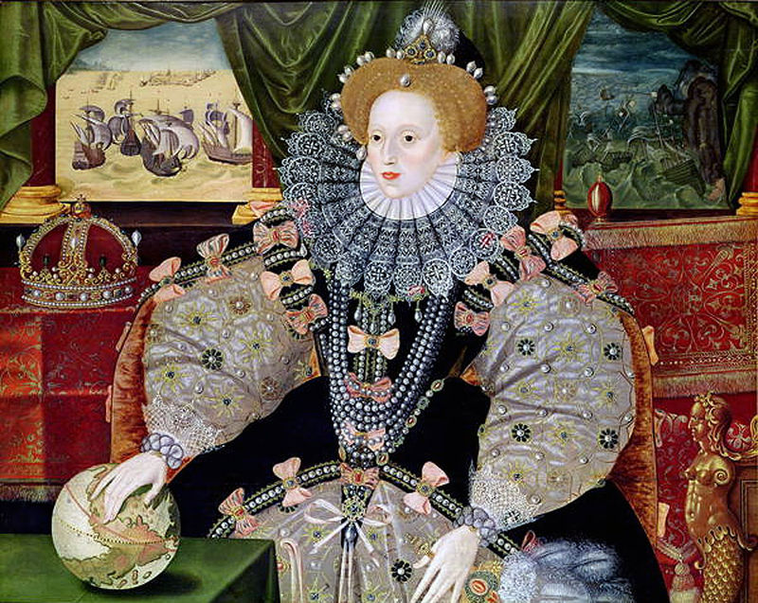
The Golden Age
Ruled England for 45 years (1558 – 1603)
Unified people; established peace and prosperity throughout
Established England as a major ruling power
1588: The Defeat of the Spanish Armada
England established as greatest naval power in the world

Slide 18
The Monarch & the Woman “I may not be a lion, but I am a lion’s cub and I have a lion’s heart.”
Elizabeth to her council on passing the Act of Uniformity (Elizabeth 52:35-6)
Elizabeth’s speech to her troops at Tilbury
Text
Film clip (entire speech)
Film clip (Elizabeth: The Golden Age)
Influence on Shakespeare?
Henry V before Battle of Agincourt: St. Crispin’s Day Speech
Notes:
Ist clip (Act of Uniformity): from DVD, Elizabeth, 52:35-6 (and not one second earlier!)
Extra link to clip on Youtube from the beginning of scene (semi-nude mistress of Norfolk), commentary on cinematography and director’s decisions to reveal male domination of period. Great commentary but incomplete—does not show the bishops in the basement or her repartee with the nobles.
https://www.youtube.com/watch?v=Owumbz0yl8U
2nd clip (Tilbury): Elizabeth: The Golden Age, 1:31

Slide 19
Elizabeth the Warrior

Slide 20
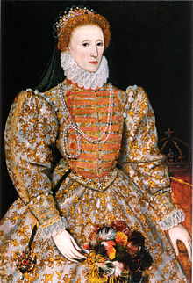
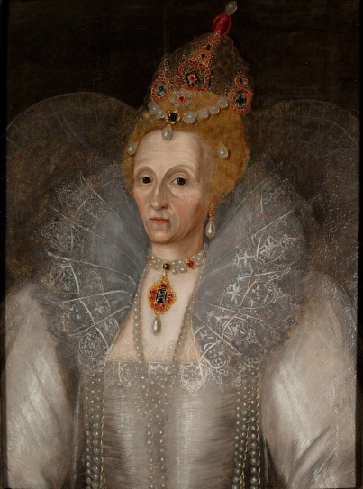
Elizabeth I: End of the Tudor Dynasty
Died in 1603 at 69 ½ years old
Childless (implications for England?)
Arranged for James VI of Scotland (Mary’s, Queen of Scots, son) to succeed her
Became James I of England, Scotland, and Ireland
Began the Stuart dynasty

Slide 21
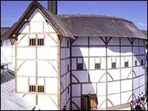
Elizabeth and the Arts
Created a stable environment for the arts to flourish
Supported them legally
1572—legalized acting
Supported them financially
was a patron
commissioned works
had acting companies perform for the court

Slide 22
Elizabeth and the Arts

