Slide 1
Shakespeare’s Theater
Elizabethan Drama and The Globe Theater

Slide 2
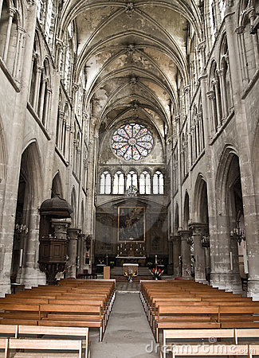
History
Began in the Medieval Church— three types:
Mystery plays
Miracle plays
Morality plays
Allegories/allegorical (structure)
Didactic (purpose)
Eventually created problems: church leaders argued that it—
Glorified sin
Led to chaos in the service
So the Pope threw drama out of the church

Slide 3
Acting in the 15th &16th Centuries
Illegal until 1572
Arguments against it (civic)
Lowered morals
Destructive for political standing
Allowed for spread of disease (The Black Plague)
Acting gained footing when first permanent theater built in 1576
James Burbage (father of Richard, leading actor of Shakespeare’s company)
Called “The Theater”

Slide 4
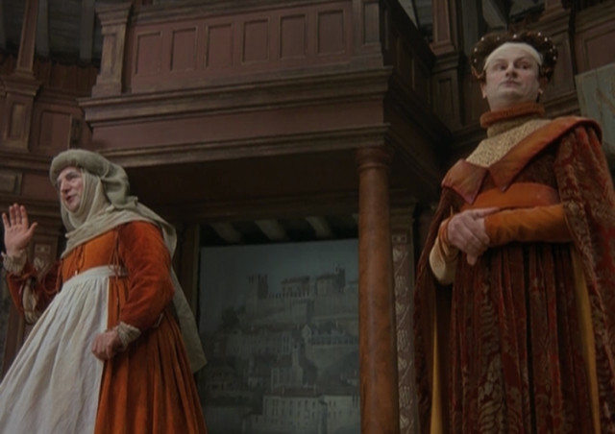
Acting Companies
Theater owners commissioned plays from writers
Acting companies associated with a particular theater (the home team)
No more than 12-15 actors in a company
Men played all parts
illegal and considered indecent for women to display themselves on stage
younger men/boys played female roles
Had to memorize a LARGE repertoire of plays and be ready to perform them at any given time

Slide 5
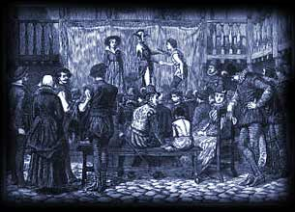
Design/Structural Origins
Bull-baiting and Bear-baiting arenas
Courtyards of Inns

Slide 6
“The Theater” → The Globe
1576: James Burbage built the first successful permanent theater in Shoreditch on the northside of the river Thames
1597: (Puritan) landlord, Giles Allen, changed mind on extending 21-year lease on property
James Burbage died before lease was finalized
Plague closed theaters; Allen didn’t want Theater to reopen
December 28, 1598 (Allen out of town for the holidays)
Dismantled Theater timber by timber
Shipped it across the Thames
Reconstructed it as The Globe
Opened for business in 1599
Notes:
Richard Burbage and younger brother Cuthbert inherited the terms of the lease, including a provision that they owned the buildings they had constructed on Allen’s land.
Source: https://shakespeareandbeyond.folger.edu/2020/12/29/raising-globe-theatre/

Slide 7
The Globe: The “Wooden O”
Wooden, 3-story octagon
Thatched roof over tiers
Open to sky and natural lighting
Thrust stage: rectangular platform surrounded by audience on three sides
Capacity: 2500-3000
No one more than 56 feet away from the stage!

Slide 8
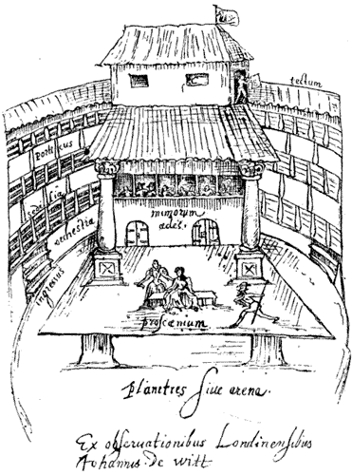
The Globe’s Social Structure
Lower class:
Paid a penny to stand around the stage
“Groundlings”
Merchant/middle class:
Sat in tiers/galleries covered by roof
Protected from weather
Paid extra for seat cushion
Nobles:
More choices for them, including the balcony and even on the stage

Slide 9
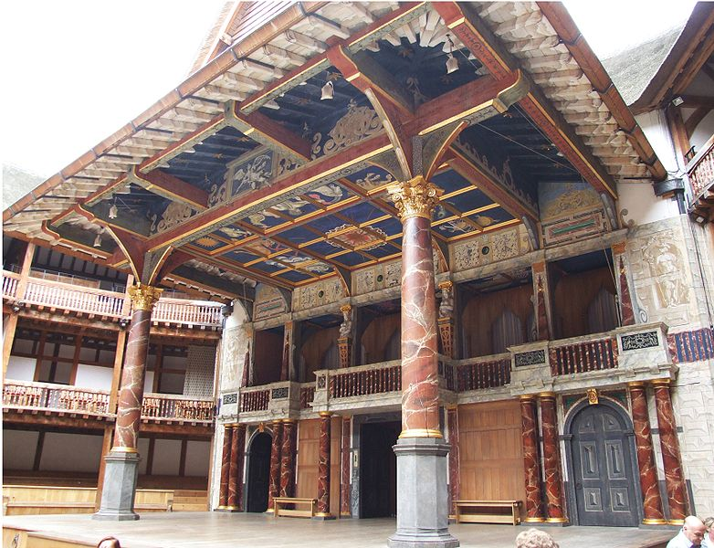
The Globe’s Stage Areas
Thrust Stage (surrounded by audience on 3 sides)
Inner stage
Balcony
Music gallery
Trap doors (hell)
Roof over the inner stage, painted to represent the heavens
No sets or scene changes—actors used different parts of stage—plays moved quickly! “the two hours’ traffic of our stage” (Romeo and Juliet)
Notes:
Image—link to new Globe virtual tour

Slide 10
What Occurred at The Globe
Before 2:00, billings posted, flag raised to signal performance for that day
Box office & seating
Vendors
Hazelnuts and oranges
Rotten fruit and vegetables
Pickpockets and cutpurses
Music—pre-show entertainment

Slide 11
More on Scenery
No sets or physical scene changes—
each scene took place on a different part of the stage
scenes moved fluidly and quickly
more like today’s cinema than today’s theater
Relied on playwright’s language and the audience’s imaginations to create the scenery

Slide 12
Time to Start: a Study in Scansion
What do modern theaters do to let people know a play is about to begin?
Flash the lights in the lobby
Turn the house lights all the way done (audience is in the dark)
Open the curtain
What did the Elizabethans do without electricity, darkness, or a curtain?

Slide 13
Actors & Accountability
Actors on the hot seat!
Daylight—could see the audience and their reactions (and play off them)
Thrust stage—surrounded by audience on three sides
No curtain/chasm/darkness that separated the audience from the actors
Fruits and vegetables!
Even people ON stage (nobility)

Slide 14
Active Audiences
Parts where players talked directly to the audience
Prologues, epilogues, choruses—
Narrator-like; speak directly to the audience
In the play but not necessarily of it—comment on it
Asides
Comments characters make directly to the audience
Other characters not supposed to hear
Ex. When Ferris Bueller looks directly into the camera and makes short comments to us that the other characters can’t hear.

Slide 15
Active Audiences
Parts where players talked directly to the audience (contd.)
Soliloquies (so-lil-lo-kweez) (singular: soliloquy)
When a character alone on stage makes a long speech, revealing his or her true thoughts to the audience
No other characters around to hear
Most famous example: Hamlet’s “To be, or not to be” soliloquy
Mel Gibson
David Tennant
Ethan Hawke

Slide 16
Active Audiences
Scenes set through language: “let us . . . on your imaginary forces work.”
Think when we talk of horses, that you see them Printing their proud hoofs i' the receiving earth; For 'tis your thoughts that now must deck our kings, Carry them here and there; jumping o'er times, Turning the accomplishment of many years Into an hour-glass. . . .
Henry V, 1.1.17, 26-31

Slide 17
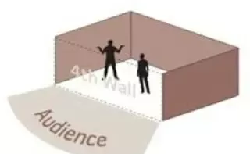
Active Audiences & Challenging Illusion What is “The Fourth Wall”?
An imaginary wall through which the audience views the play
Under the proscenium arch across the front of the stage
Closes the box around/contains the illusion
Separates the audience from the actors and the make-believe world of the play
“We treat this wall like a one-way mirror. The audience can see and comprehend the story, but the story cannot comprehend the existence of the audience” (Studiobinder)

Slide 18
Active Audiences & Breaking the Fourth Wall
aka Challenging Illusion:
“when an actor breaks the invisible line between performer and viewer and dispels the illusion that the viewer is buying into” (The Women of Letters)
“doing or saying something that either explicitly or implicitly acknowledges the artificiality of the environment and the fact that both the presenters and audience are aware of that artificiality” (Wigmore)
talking directly to/acknowledging the audience
breaking out of character; meta-awareness
“a metalepsis (the transgression of narrative levels) . . . a technique often used in metafiction. . . . when a character within a literary work acknowledges the reality that they are in fact a fictitious being.”
making a reference to anything that pulls the audience out of the imaginary world (the illusion)—where both actors and audience are aware

Slide 19
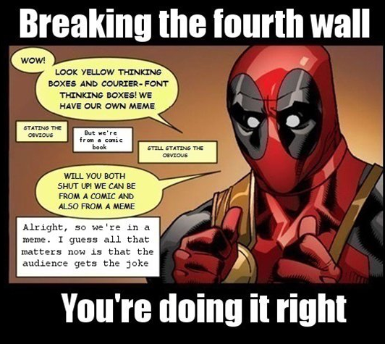
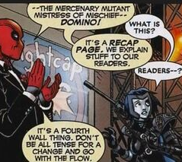
Active Audiences & Breaking “The Fourth Wall”
Images from Quora

Slide 20
More on Challenging Illusion
Julius Caesar Hence! Home, you idle creatures, get you home! Is this a holiday? What, know you not, Being mechanical, you ought not to walk Upon a laboring day without the sign Of your profession? (1.1.1-5)
Macbeth (Banquo to Witches) “ . . . you should be women,/ And yet your beards forbid me to interpret/ That you are so” (1.3.46-48).
Henry V (opening chorus)

Slide 21
More on Challenging Illusion
Hamlet O, it offends me to the soul to hear a robustious periwig-pated fellow tear a passion to tatters, to very rags, to split the ears of the groundlings, who for the most part are capable of nothing but inexplicable dumbshows and noise. . . . (3.2.8-13)
References to theater—remind audience that they are a part of what’s going on here
Giving acting directions to actors on stage—making fun of bad ones
Cracking on the groundlings!

